Slide 1
EMC IT Proven Data Protection Solution
Overview

Slide 2


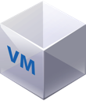

Protect Data Wherever It Lives
Data protection is not one size fits all
On Premise
Virtual
Hybrid
Born In The Cloud
Notes:
First, let’s consider the typical data protection environment in today’s world. The reality is that most customers are managing and protecting their applications and data in multiple places; from on-premise traditional infrastructures to virtualized environments to hybrid and public clouds. This calls for a data protection strategy that acknowledges the current landscape- because it is likely customers will need to support more than one of these environments for some time. With that in mind, customers need a solution that is flexible, comprehensive, and designed to protect data across consumption models.

Slide 3

Data Protection Continuum
Protection and Continuity
Based on Data Value and
Business Objectives
Availability
Replication
Snapshot
Backup
Archive
Notes:
Not only do customers need to be protected across all consumption models, they also need a solution that spans the data protection continuum. In terms of service levels, there is no one size fits all solution. Protection should be based on data value and service levels that align to business objectives. The Data Protection Suite Family presents a solution to fit all types of data requirements, from replication to snapshot to backup and archive.
Our industry-leading availability and mobility solution, VPLEX, is not included in the Data Protection Suite Family and can be purchased separately.

Slide 4

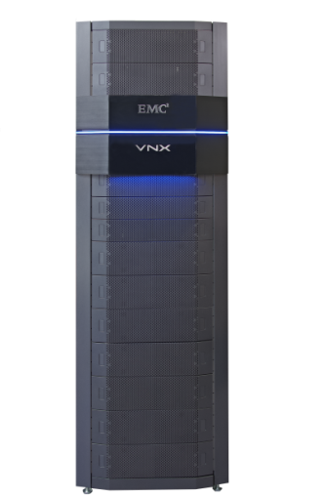





DATA PROTECTION FOR EVERY SLA
12AM
6AM
8AM
12PM
6PM
8PM
12AM
VPLEX
AVAILABLITY
3:27PM
8AM
10AM
12PM
2PM
4PM
6PM
8PM
10PM
12AM
RecoverPoint
CONTINUOUS
1 Min
8AM
1PM
6PM
11PM
2+ Hrs
ProtectPoint
SNAPSHOTS
Data Protection Suite
Data Domain
12AM
12+ Hrs
12AM
BACKUP
Continuous
Availability
Synchronous
Replication
Asynchronous
Replication
Point in Time
Replication
Backup and
Recovery
Archive
DATA CORRUPTION OCCURS AT 3:28pm
Zero
Seconds
Minutes
Data Protection Continuum
Notes:
Flexible architecture to meet any customer RPO & RTO requirements
1st Click – shows corruption time
2nd Click – shows 12+ hrs RPO arrow
3rd Click – shows “Snapshots” box. With 2+ Hrs RPO arrow
4th Click – shows “ Continuous” replication box
5th Click – shows the rest of the animation, 1 Min RRP & Text box…. Minimize RPO & RTO.
Speaker Notes:
If you rely on backup only, your recovery point is determined by the last tape or backup to disk job you created.
Depending on when the operational error occurs, you may be faced with a recovery point that is hours in the past and all the data in between is lost.
With the cause being fat fingers, viruses, corruption or data over-runs the IT organizations can no longer rely on backups alone and are complementing backup solutions with snapshots to shorten that window, but it still could be 2-3 hours long. Not ideal when it comes to the increasing demands being placed on data protection.
But business requirements are becoming more and more demanding the challenge of resolving corrupted and lost data becomes more and more vital to IT organizations
Because of the high costs and increasing pressure to reduce of data loss and downtime, traditional approaches to data loss are no longer sufficient.
Many organizations are now moving to Continuous Data Protection because it enables any point in time recovery – for recovery to the millisecond, like using a unique DVR-like rollback mechanism.
Using RecoverPoint you can bookmark specific points in time that might be used during a future recovery and also create application-aware bookmarks that annotate specific points in time that are application-consistent.
With RecoverPoint, once the data is recovered you can re-start your applications at any PIT to achieve near zero data loss (Optimized RPO) and minutes of RTO.

Slide 5
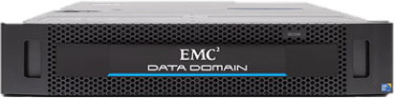
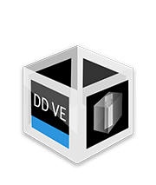
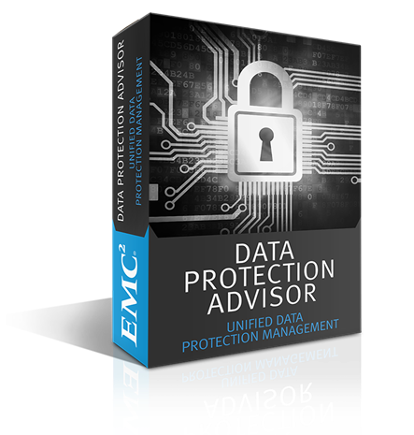
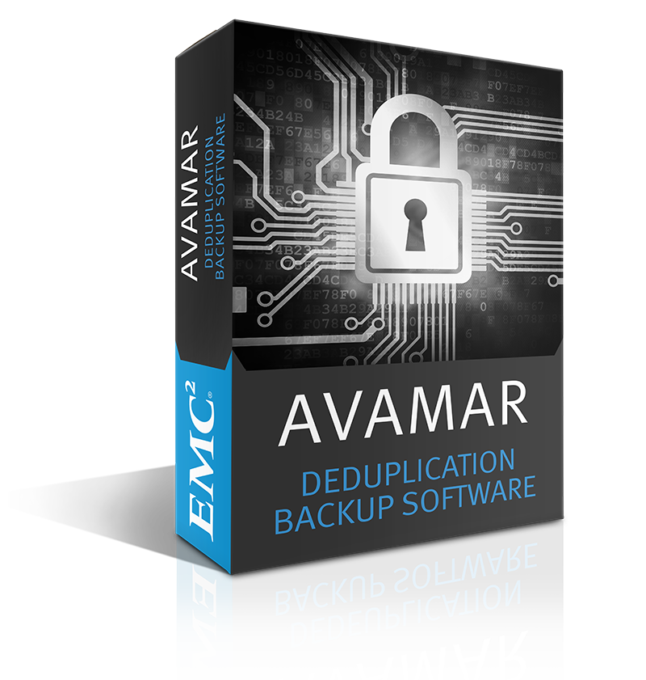
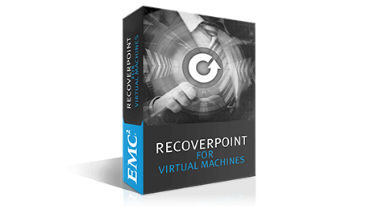
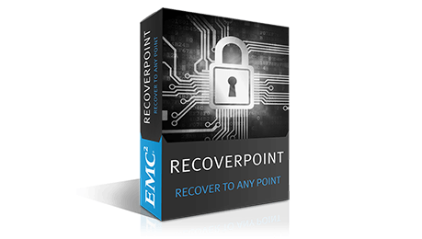
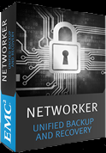
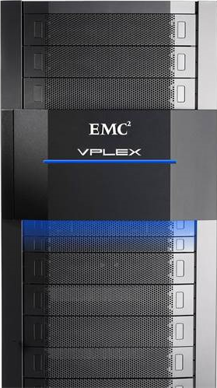
Data Protection Product portfolio
DD
DD VE
Avamar
Networker
VPLEX
RP
RP4VMs
DPA

Slide 6

Data Protection Everywhere
Our Unique Strategy
Where You Need
It
Consumption
Models
Born in the
Public
Private
Robo
Cloud
On-Prem
Virtualized
Converged
SaaS
RTO & RPO
Protection
Storage
Continuous
IRS
“Air Gap”
Availability
Replication
Snaps
Backup
LTR/Archive
How You Want
It
Best of Breed
Converged
Software Defined
As-a-Service
Notes:
At Dell EMC we believe data needs to be protected wherever it lives and no matter what happens. With this in mind we start with the reality that Data Protection cannot be one size fits all in terms of service levels. Protection and availability should be based on data value and service levels that align to business objectives. And this data needs to be protected across consumption models from on-premise to born in the cloud. Finally, we believe in providing you choice in how this technology is consumed. Now, let’s dig into the details of how Dell EMC Data Domain helps you achieve this.

Slide 7
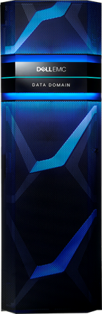
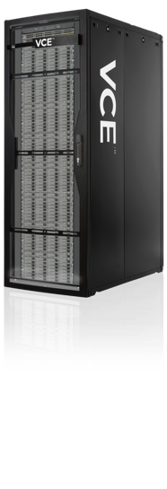
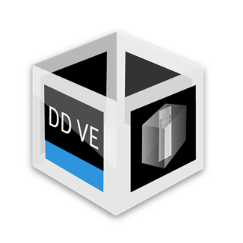
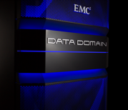

Protection Storage How You Want It
How You Want
It
Best of Breed
Integrated
Software Defined
As-a-Service
Notes:
Data Domain is flexible as it can be consumed in a variety of deployment models, so you can gain the benefits of the leading protection storage however it best fits into your environment. This includes the traditional best of breed Data Domain system, an integrated data protection appliance or as a part of a converged system, software-defined protection storage, and acquiring through one of our partners in an as-a-service model.

Slide 8
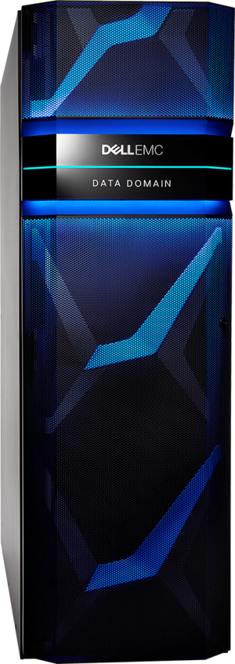
Dell EMC Data Domain Systems
Most trusted protection storage
Efficient
Protect more data faster with industry leading speed and scale
Reduce storage required by 10–30x
Reliable
End-to-end data verification, fault detection, and self healing
Flexible
Integrates with leading backup, archiving, and enterprise applications or directly with primary storage
Deploy protection storage however you want it
Cloud-enabled
Natively tier deduped data to the cloud for modern long-term retention
Deliver data protection as a service with logical data isolation
Notes:
Data Domain delivers the most trusted protection storage in the market. With unmatched efficiency brought about through Dell EMC’s industry-leading deduplication, scalability, reliability, and performance.
Protection storage from EMC is flexible, with the ability to backup directly from enterprise apps or primary storage. Plus, Data Domain is available How You Want It depending on the demands of your environment.
And finally, Data Domain is cloud enabled, with native tiering of deduped data to public, private or hybrid clouds for long-term retention and secure multi-tenancy capabilities that enable enterprises & service providers to deliver Data Domain in a private/public cloud.

Slide 9
Data Domain Hardware Appliance Introduction

Slide 10












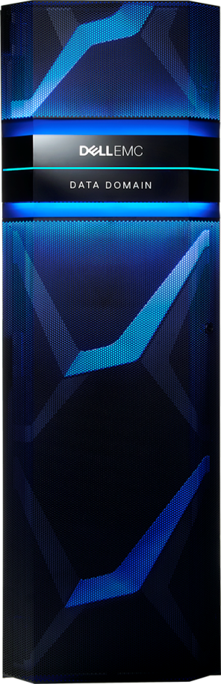



The Ultimate Protection Storage
Protect everything on a single platform
Databases
E-mail servers
Virtual machines
File shares/servers
Enterprise applications
Content management
Backup
Archive
Database
Mainframe
IBMi
Big Data
File/E-mail
VMware
NAS
ROBO
File
E-mail
Big data
Content management
Storage tiering
Database
Standard network protocols
DD Boost, CIFS, NFS, VTL, NDMP
Disaster recovery
Long-term retention
Notes:
Now, let me take you through how Data Domain systems are the ideal protection storage platform for backup and archive data. On the top here, you can see a variety of data sources including databases, e-mail servers, virtual machines and more. One of the main strengths of Data Domain systems is that all of these data sources and broad range of backup and archive use cases can be protected on a single system.
One of the key differentiators Data Domain systems offer is the ability to deduplicate and encrypt data inline as it is written to disk. Furthermore, on the archive side, Data Domain systems can meet a variety of US and international compliance regulations for archive data.
All data sent to a Data Domain system can be efficiently replicated to a secondary site for disaster recovery or to the public, private or hybrid cloud for long-term retention

Slide 11
Not All Dedupe is Created Equal
Superior efficiency with variable-length deduplication
Friday full backup
Backup Estimated
data Logical reduction Physical
A
B
C
D
A
E
F
G
Mon incremental
Friday full 1 TB 2–4x 250 GB
A
B
H
Tues incremental
Monday incremental 50 GB 7–10x 5 GB
C
B
I
Weds incremental
Tuesday incremental 50 GB 7–10x 5 GB
E
G
J
Wednesday incremental 50 GB 7–10x 5 GB
Thurs incremental
A
C
K
Second friday full backup
Thursday incremental 50 GB 7–10x 5 GB
B
C
D
E
F
L
G
H
Second Friday full 1 TB 50–60x 18 GB
A
B
C
D
E
F
G
H
I
J
K
L
Total 2.2 tb 7.6x 288 GB
Notes:
Data deduplication enables you to store more data in smaller footprint by only storing data that is unique. However, not all deduplication is created equal. One of the core features inherent to Data Domain is its superior dedupe technology. The example here illustrates how this works:
(click)
On Friday, the backup application initiates the first full backup of 1 TB, but only 250 GB is stored on Data Domain. This occurs because Data Domain deduplicates data INLINE before it is written to disk. Additionally, Data Domain’s dedupe is variable-length, meaning data is intelligently segmented, ehancing the ability to identify redundant data, which dramatically reduces storage requirements. On average this results in a two- to four-time reduction in data on a first full backup.
Over the course of the week, 50 GB daily incremental backups result in a seven- to 10-times reduction and only require 5GB to be stored. As the graphic on the left shows, during the week incremental backups contain data that was already protected from the first full backup.
Finally, on the second Friday, the second full backup contains almost all redundant data. Therefore, of the 1 TB backup dataset, only 18 GB needed to be stored.
In total, over the course of a week, 2.2 TB of data was backed up to Data Domain, but the system only required 288 GB of capacity to protect this dataset. Overall, this resulted in a 7.8-times reduction in just one week. These benefits become even greater over the span of a few months – with an average reduction of 10 to 30x over that period of time – the highest dedupe ratios in the industry.

Slide 12
Most Reliable Protection Storage
Data Domain Data Invulnerability Architecture
Stored correctly
Stays correct
Recovers correctly
✓
✓
✓
Inline data verification
✓
Continuous fault detection and self- healing
✓
Recovery/access
Verification
✓
Notes:
Another key differentiator is the Data Domain Data Invulnerability Architecture which is built into every Data Domain system and provides the industry’s best defense against data integrity issues. Through inline right and read verification your data is protected and it can be automatically recovered from data integrity issues during data ingest and retrieval so data is stored correctly. With continuous fault detection and self healing your data stays correct throughout its lifecycle on the Data Domain system and returns correctly ensuring that the data is recoverable and accessible when you need it.

Slide 13


Faster, More Efficient Backup
Data Domain Boost
Advanced integration with leading backup and enterprise applications
Speeds backups by up to 50%
Reduce network utilization by up to 99%
Notes:
Another important feature of Data Domain is Data Domain Boost software, which recognizes that traditional backups are too slow to keep up with our data centers today. DD Boost provides businesses with a faster and smarter way to do your backups. It does this by distributing parts of the deduplication process upstream to the application or backup server. So, only unique data is sent over the network to the Data Domain system. This speeds backups by up to 50%, reduces the impact on the server by 20 to 40%, and reduces the impact on the network by 80 to 99%. In addition, DD Boost enables the application to control the Data Domain replication process with full catalog awareness of both the local and remote copies of the backup.

Slide 14






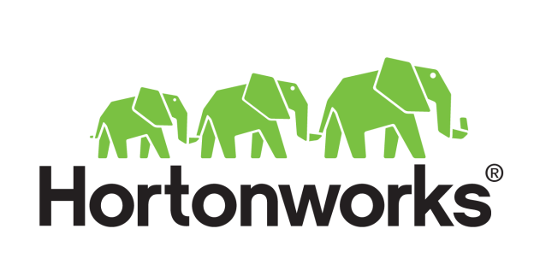
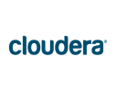
Empowering Application Owners
DD Boost for Enterprise Applications
50%
Native app integration
Faster backup
Efficient backup & replication
WAN
Mtree replication
Controlled by app team
Notes:
Data Domain can integrate directly with enterprise applications, which allows application owners to have control and visibility of their own backups to Data Domain systems using their native tools. By giving the Application owner control of the recovery process, he does not need to go through the Backup Admin enabling faster recovery. Plus, {CLICK} client-side deduplication enabled by DD Boost speeds backups by 50% and reduces bandwidth requirements up to 99%.
DD Boost for Enterprise Applications can be purchased through: Data Protection Suite for Applications, Data Protection Suite for Backup and Data Protection Suite Enterprise Edition.

Slide 15




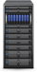
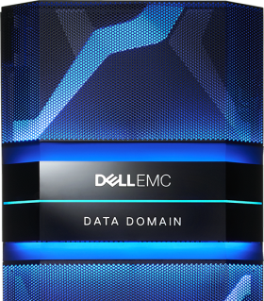
Data Domain Boost Ecosystem
NetBackup
Backup
Exec
VDP Advanced
Data Protector
Greenplum
SAP
SAP HANA
SQL,
Exchange
Avamar
NetWorker
vRanger
NetVault
Veeam
RMAN
DB2
HortonWorks
Cloudera
App
Server
Backup Server
DD Boost
Supported over LAN
DD Boost
Supported over SAN
DD Boost
Supported over WAN
For everything else, use the
DD Boost file system plug-in
Notes:
By integration with leading backup, enterprise applications and Big Data Applications on Hadoop, DD Boost has a broad ecosystem to integrate with a range of customer environments. For other applications not listed above, EMC offers scripted support through DD Boost File System Plug-in.

Slide 16
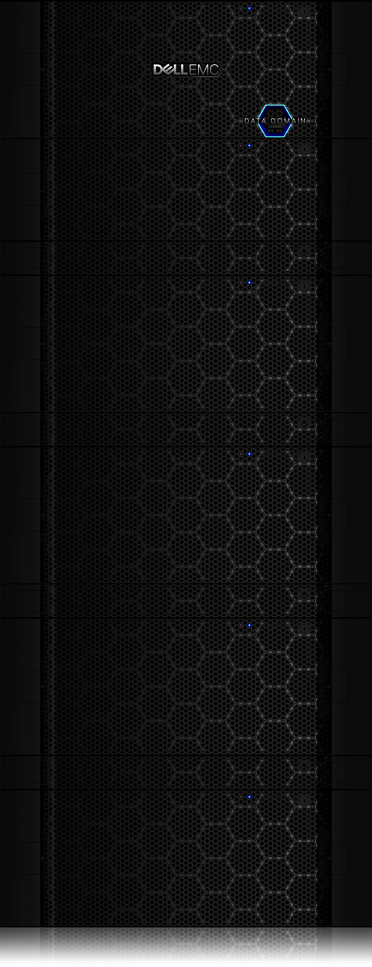
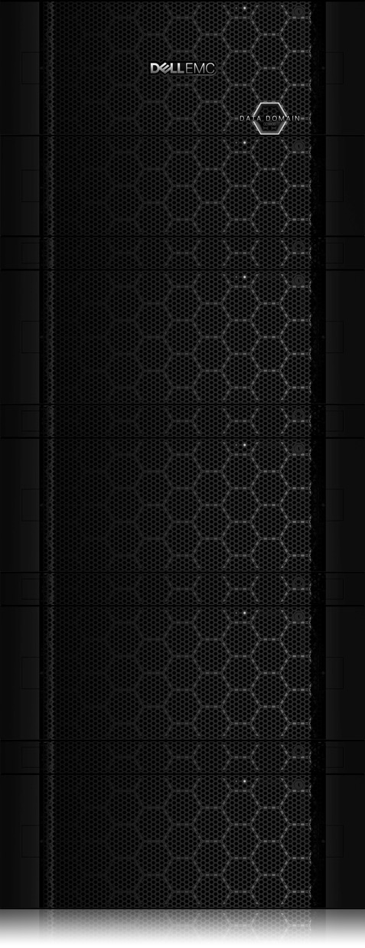
High Availability
ACTIVE Controller
STANDBY Controller
HA Interconnects
High availability of backup, archive, and recovery data on Data Domain ensures operational continuity to minimize downtime for users and processes.
HA configurations are supported on DD9800, DD9300 & DD6800 and the legacy DD9500
Delivering business continuity for both Large and Midsized Enterprises
Notes:
With high availability support for DD9800, DD9300 & DD6800 and the legacy DD9500, enterprise & midmarket customers can dramatically minimize downtime by enabling business continuity in the face of sudden hardware failures. High availability ensures continuous operational access of backup and archive data.
With high availability, failover is enabled between two Data Domain controllers. During unplanned system downtime such as a sudden hardware failure, failover activates between the two controllers to achieve business continuity. Backup jobs will pause on the active controller and failover to the standby node, where they can resume operations in just minutes.

Slide 17
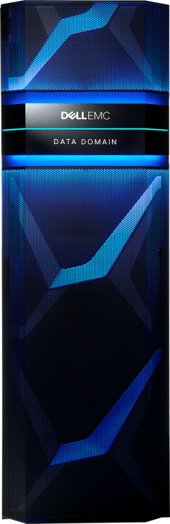


Secure Multi-Tenancy
Delivering data protection as a service
Deliver data domain in a private/hybrid cloud
Logically isolate user data for secure self-service
Tenant-level management and reporting
Tenant unit A
Tenant A
Tenant unit B
Tenant B
Notes:
Secure multi-tenancy enables large enterprises and services providers to offer data protection as a service with Data Domain systems in a private or hybrid cloud. With secure multi-tenancy, a Data Domain system can logically isolate data and restrict each tenant’s visibility and read/write access to only their data. In addition, secure multi-tenancy provides management and monitoring by tenant to enable chargeback, trending and other reporting. Secure multi-tenancy is built into DD OS with no software option required and is available for all supported backup, archiving and enterprise applications.

Slide 18
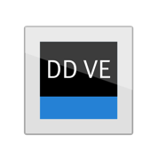
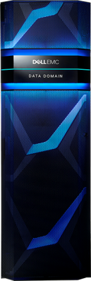
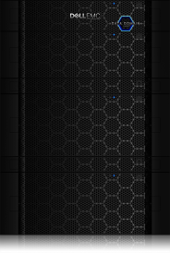
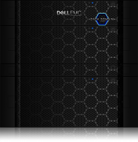

Data Domain Family
Small Enterprise/ROBO – Midsize Enterprise
Large Enterprise
Speed (DD Boost): 5.6 TB/hr (16TB), 11.2 TB/hr (96 TB)
Usable capacity: .5 TB – 96 TB, Logical capacity: Up to 4.8 PB
Data Domain Virtual Edition
Midsize Enterprise
Small Enterprise
/ROBO
 | DD2200 | DD6300 | DD6800 | DD9300 | DD9800
Speed (DD Boost) | 4.7 TB/hr | 24 TB/hr | 32 TB/hr | 41 TB/hr | 68 TB/hr
Speed (other) | 3.8 TB/hr | 8.5 TB/hr | 14 TB/hr | 20 TB/hr | 31 TB/hr
Logical capacity | 40–860 TB | 1.8–8.9 PB | 2.8–14.4 PB¹ 8.4–43.2 PB² | 7.2–36 PB¹ 21.6–108 PB² | 10–50 PB¹ 30–150 PB²
Usable capacity | Up to 17.2 TB | Up to 178 TB | Up to 288 TB¹ Up to 864 TB² | Up to 720 TB¹ Up to 2.16 PB² | Up to 1 PB¹ Up to 3 PB²
¹ With DD Extended Retention software option
¹ Total capacity on Active Tier only
² Total capacity with DD Cloud Tier software for long-term retention
³ DD Extended Retention is also available for long-term retention
Notes:
Here is a look at the new Data Domain systems and the category-shattering performance & scalability they each achieve.
DD6800, DD9300 & DD9800 each support Data Domain Cloud Tier. DD Cloud Tier allows up to 2x the capacity of the Active Tier to be natively-tiered to the cloud for long term retention. Here is a look at the total capacity of the active tiers of these systems & the total capacity with Data Domain Cloud Tier in addition.
Note: Throughput drawn running DD VE in the following environment: Host server: 2x Intel Xeon CPU (6 Cores each) @ 2GHz, 128GB memory, 2x10GbE NIC; Storage: DAS with 3TB 7200RPM SAS Drives, RAID6, Battery Powered HBA Cache Enabled, Disk Cache Disabled

Slide 19
Data Domain Integrated & Converge Solution

Slide 20
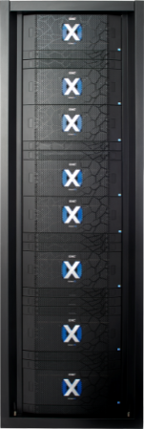

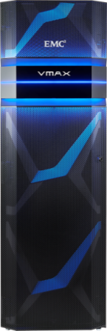
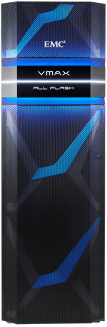

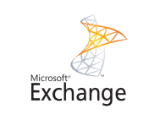

Storage integrated protection
ProtectPoint
20x
Faster backup & recovery
Eliminate impact on application
Reduce cost and complexity
Faster backup
10x
Faster recovery
Notes:
Dell EMC ProtectPoint eliminates backup impact on applications by removing the server from the data path. Unlike a traditional backup, ProtectPoint only pauses the application to mark the point in time for an application-consistent backup, after which the application can quickly return to normal operations. ProtectPoint also allows customers to meet SLAs by backing up directly from Dell EMC primary storage to an Dell EMC Data Domain system.
By eliminating traditional backup applications, ProtectPoint enables faster, more frequent backup for enterprise applications. ProtectPoint gives application owners and database administrators for Oracle, Microsoft SQL and Exchange, SAP, and IBM DB2, complete control of their own backup and recovery directly from their native application utilities. This empowers application owners by giving them the control they want without additional cost and complexity. The ProtectPoint solution requires XtremIO, VMAX3 or VMAX All Flash.
ProtectPoint can be purchased through: Data Protection Suite for Applications and Data Protection Suite Enterprise Edition.

Slide 21
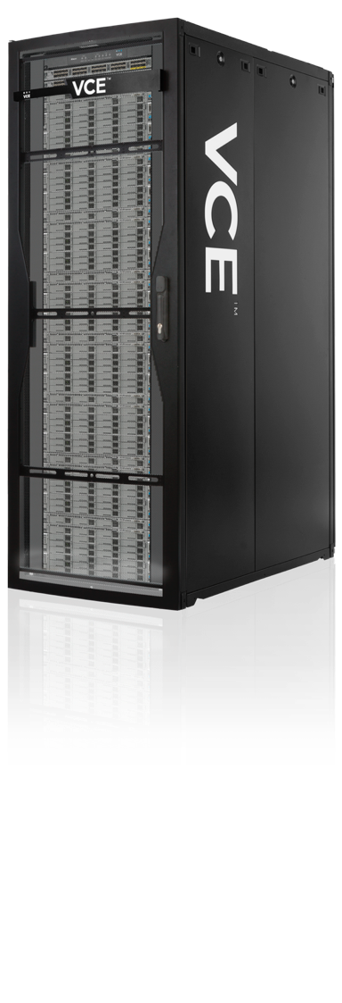
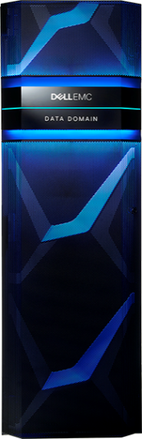
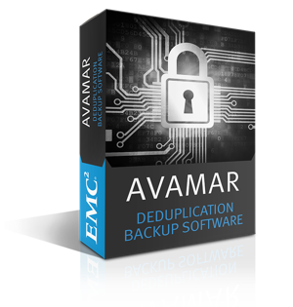
VCE Data Protection Appliance
Integrated data protection offering
Includes best of breed Dell EMC technology in a converged offering
Data Domain with Avamar
20 TB to 288 TB usable
75% faster time to value with rapid deployment
Notes:
With this in mind, the VCE Data Protection Appliance brings together best of breed protection storage and protection software with Data Domain and Avamar. So, you can get the industry’s best deduplication, performance and reliability in a single solution that comes in a range of capacity points. As a simple to deploy converged solution, the time to value is reduced by up to 75%.

Slide 22
Data Domain SDDC & Cloud Solution

Slide 23
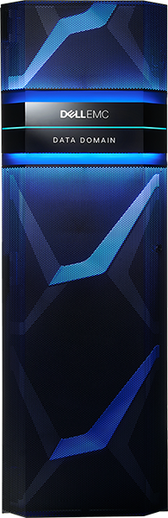

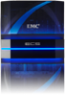


Data Domain Cloud Tier
Unparalleled efficiency for tiering protection storage to the cloud
Simple: automated, native tiering to public, private or hybrid cloud
Cost-effective: send and retrieve only unique data for lower TCO
Open: broad ecosystem and flexible deployment options
Elastic Cloud Storage
3rd Party
Public Clouds
Long-term Retention
Notes:
To help customers simplify and automate their path to the cloud, Data Domain provides native tiering of deduplicated data to the cloud with Data Domain Cloud Tier. This best of breed technology allows businesses to gain the advantages of cloud while lowering overall TCO.
The highlights of Data Domain Cloud Tier are that is is:
Simple with automated tiering directly from Data Domain to the public, private or hybrid cloud for long-term retention
Cost-Effective by sending only unique data to cloud storage for reduced storage footprint and network bandwidth
And open by supporting a broad ecosystem of backup applications and the ability to move data to a variety of public and private clouds including EMC Elastic Cloud Storage (ECS) and Virtustream Storage Cloud
DD Cloud Tier is also secure by providing the ability to encrypt data in the cloud.

Slide 24
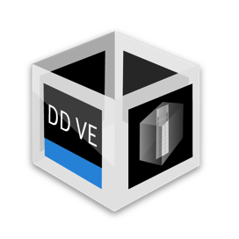
Data Domain Virtual Edition
Software defined protection storage
Download and deploy in minutes
Flexible capacity scales up to 96 TB
Leverage existing infrastructure
Typical use cases
ROBO
Small mid-sized Data Centers
Backup as a service (BaaS)
Replication as a service (RaaS)
Validated solution
DELL Power Edge Server
VxRail Solution
Notes:
Data Domain is also available as a software-defined solution with Data Domain Virtual Edition. DD VE is simple to download and deploy – it can be up and running in just a matter of minutes. It scales up to 96 TB per instance and you can pay as your grow in as little as 1 TB increments and distribute this capacity in multiple instances as needed across their environment. DD VE can run on standard hardware, so customers can leverage existing infrastructure to deploy protection storage.
Data Domain Virtual Edition maintains the core Data Domain features that differentiate it as the industry-leading protection storage. This includes high-speed, variable length deduplication, unparalleled data integrity to ensure reliable recovery, and a broad ecosystem of backup and archive applications. DD VE also comes with DD Boost, DD Replicator and DD Encryption.
[NOTE] No support for: DD Extended Retention, DD VTL, Fibre Channel
Backup Apps supported: NetWorker, Avamar, DD Boost for Enterprise Apps, Backup Exec, NetBackup, HP Data Protector, CommVault, Oracle RMAN, TSM, NetVault, VDP
Archive Apps supported: Source One, Enterprise Vault, CTA, OpenText

Slide 26




Continuous Replication
DATA PROTECTION CONTINUUM
Replication
Snapshot
Backup
Archive
Any point-in-time recovery
Consistent recovery of inter-dependent applications
Integrated vCenter management and orchestration
Disaster and operational recovery
Software-only solution
Simple
Efficient
Proven
Notes:
We provide continuous data protection for any point-in-time recovery. The Data Protection Suite Family, specifically Enterprise Edition and the Suite for VMware, provides simple, efficient, and proven continuous replication:
Delivers any point-in-time recovery and optimizes RPO/RTO for applications and VMs. This includes the ability to restore inter-dependent apps to a consistent state.
Provides local and remote replication over any distance with sync or async replication.
A plugin provides full integration with VMware vCenter, enabling the vCenter admin to manage data protection from vCenter.
Advanced orchestration includes automated workflow that enhances the operational and disaster recovery processes, reducing data loss and the time required for recovery. Advanced orchestration enables the support of the VM, the environment and the protection plans to self-adjust to changes.
Supporting customers in their quest for the agility and flexibility afforded them by a Software Defined Data Center, this solution is 100% software defined.

Slide 27

Storage Integrated Data Protection
DATA PROTECTION CONTINUUM
Replication
Snapshot
Backup
Archive
Backups
+
Snapshots
Cost Effective
No App Impact
Reliable Recovery
RPO = Minutes
App Integration
Minimal RTO
Notes:
The Dell EMC Data Protection Suite Family provides the best of both worlds data protection.
Specifically – the benefits of backup from Dell EMC include:
Cost effective retention with Data Domain deduplication that reduces backup storage requirements by up to 30x
Corruption protection than ensure data remains recoverable via the Data Domain Data Invulnerability Architecture
Native application integration with agents that empower application owners and DBAs to control their own backup and gain application consistent backups for simplified recovery.
Array based snapshots provide a couple features that backup cannot, specifically:
No impact on the application server
An RPO of minutes or hours
And minimal RTO
The comprehensive protection provided by Data Protection Suite Enterprise Edition, as well as Data Protection Suite for Applications, combines all of these benefits to provide the functionality of backup with the performance of snapshots.

Slide 28

Snapshot Management
DATA PROTECTION CONTINUUM
Replication
Snapshot
Backup
Archive
Policy-based lifecycle data protection management for snapshot copies
Support for both SAN and NAS arrays
Non-disruptive live backup
Rollover to backup media for longer retention
Application aware
Exchange, SQL, DB2, Oracle, SAP, and SAP with Oracle
Notes:
Data Protection Suite also integrates snapshot management technology that leverages both block and file-based array snapshots for faster RTO/RPO’s with the option to rollover a snapshot to highly efficient Data Domain systems for lower cost long-term retention and disaster recovery. It centrally catalogs and manages the snapshots and the backup savesets with granular level recovery supported from both. Snapshot actions can be chained with other backup tasks, such as replication or clone to cloud for long term retention, to form policies in support of an enterprise’s data protection plans. We also provide lifecycle policies for snapshot savesets. Snapshot policies specify the time interval between snapshots and the maximum number of snapshots to be retained, above which the older snapshots are recycled, and finally, which snapshots will be backed up for operational or disaster recovery. Backup happens on a proxy-host and thus, is non-disruptive.
These snapshot capabilities are a result of the underlying technology of Data Protection Suite, in the form of NetWorker, included in Data Protection Suite Enterprise Edition and Data Protection Suite for Backup. NetWorker provides application aware protection on SAN arrays for DB2, Oracle, and SAP with Oracle. It should also be noted that Data Protection Suite Enterprise Edition is application aware through EMC AppSync, with support for Oracle, Microsoft SQL Server, Microsoft Exchange, and VMware VMFS and NFS datastores and File Systems.

Slide 29

Backup and Recovery
DATA PROTECTION CONTINUUM
Replication
Snapshot
Backup
Archive
Up to 20x faster backup with Storage Integrated Data Protection
Up to 30x faster image-based recovery
Cloud-enabled, both IN the cloud and TO the cloud
Empowers app owners to work within their native utilities
Tightest integration with Data Domain
Heterogeneous platform support across a broad range of apps
Daily full backup
Never backup the same data twice!
Notes:
The backup and recovery capabilities of the Data Protection Suite Family tightly integrate with Data Domain, providing an industry-leading backup and recovery software solution for protection across the enterprise. DD Boost, purchased separately, provides unique client-side global deduplication technology which eliminates redundant backup data sent over the network and stored. It is integrated with both Avamar and NetWorker and deduplicates at the client, whether virtual or physical, and across sites and servers, thus lowering costs and removing risks associated with traditional backup. Further, the unique capabilities of Avamar, as well as NetWorker Block Based Backup, technologies enable you with a daily full backup every time – you never have to backup the same data twice!
Specifically, Data Protection Suite Enterprise Edition and Data Protection Suite for Applications boasts 20x faster backup thanks to ProtectPoint’s storage integrated data protection capabilities. And with Avamar, image-based recoveries are up to 30x faster than competitors.
All offerings within the Data Protection Suite Family are cloud-enabled, delivering highly-efficient, secure long-term retention of backups to the cloud, as well as backups of data and applications within the public cloud.
The powerful combination of Data Protection Suite with Data Domain yields impressive results, including 99% reduction in network traffic, up to 30x reduction in backup storage, and 50% reduction in backup time. Data Protection Suite and Data Domain are more tightly integrated than competitors software, enabling higher dedupe rates and greater ease of installation and use.
Providing flexibility and choice, each Data Protection Suite offering empowers app owners to work within their native utilities, while also delivering heterogeneous platform support for the broadest range of apps.

Slide 30

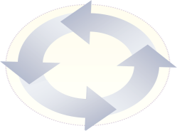
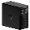
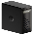


DATA PROTECTION CONTINUUM
Archive
Replication
Snapshot
Backup
Archive
Archive long-term inactive business data
Reduce primary storage utilization
Manages risk to help meet compliance and litigation needs
Enable data search & discovery
Improve operational efficiencies
Notes:
A lot of people think backup itself can solve all of the data protection challenges companies face today. However, backup is in fact quite different from archive.
Backups are secondary copies of active production information used when a recovery copy is needed to get an end user back to work, or—in the case of a disaster—to get the business back up and running. Since backups are focused on constantly changing business information, they are generally short-term and often overwritten when full backups are taken. This makes backup a poor choice for retaining data for compliance reasons.
Archive, on the other hand, is not a copy of production data, but rather the primary version of a piece of data, often inactive or non-changing. When data stops changing or is no longer frequently used, it is best to move it to an archive, where it lives outside the backup window but can still be accessed. Archives do not focus on "recovering" an application or business data, but allow for information retrieval. They are typically used for long-term retention of information, and thus are the best choice for managing data with regulatory compliance requirements.
For a complete data protection strategy, you need both backup for disaster recovery and archive for very long-term retention.
Data Protection Suite Enterprise Edition and Data Protection Suite for Archive come complete with industry-leading archive solutions. With archive as a part of your data protection strategy, you can reduce storage cost, streamline compliance process, enable data search and discovery, as well as improve operational efficiencies. Archiving can be thought of as a process of moving data to a less costly tier to help enforce long-term retention and regulatory compliance.
The compliance department has a lot to gain, too. Most customers have retention policies for email and files but they are rarely followed or enforced. Archiving can help companies to automate, audit and defend their retention policies, which are frequently just words on paper that are ignored by everyone. For compliance, this reduces the risk of penalties and fines by helping customers bring more of their legal eDiscovery work in-house. Creating a repeatable business process for locating and processing content for eDiscovery will substantially cut risk, and can result in legal savings.

